Slide 1
Population census pattern analysis and prediction system
Presentation By-
Archon Kashyap
MCA
GIMT, Ghy

Slide 2
Project Overview
A location's growth is greatly influenced by its population. Available information on historical development, as well as the future development of the population in a country is essential for planning processes in politics and business administration.
Computer Science is now at a point where predictive algorithm as one of the areas of Machine Learning(ML) is becoming more important and indispensable. Machine learning algorithms can detect uncertainties on demographic data and analyze historical data to better estimate the population of the country.
In this project, in order to assess the effectiveness of the models, prediction results from a variety of methods have been compared using population data of India from 1955 to 2022 .

Slide 3
Literature Review
“Using Predictive Machine Learning Regression Model To Predict The Population Of Nigeria” , “Machine Learning Algorithms to Forecast Population: Turkey Example” focusses on applying regression model into population dataset.
“The application of ARIMA model in forecasting population data” by Jie Dai and Shuping Chen uses the power of ARIMA to predict Zhejiang Province’s population.
Regression models and time series models are mostly used while predicting population.

Slide 4
Methodologies
Models used in the project –
Linear Regression
Multivariate Linear Regression
ARMA (Autoregression Moving Average)
ARIMA (Autoregression Integrated Moving Average)
ANN(Artificial Neural Network)
Methods used for Error Calculation –
RMSE(Root Mean Squared Error)
MAPE(Mean Absolute Percentage Error)

Slide 5
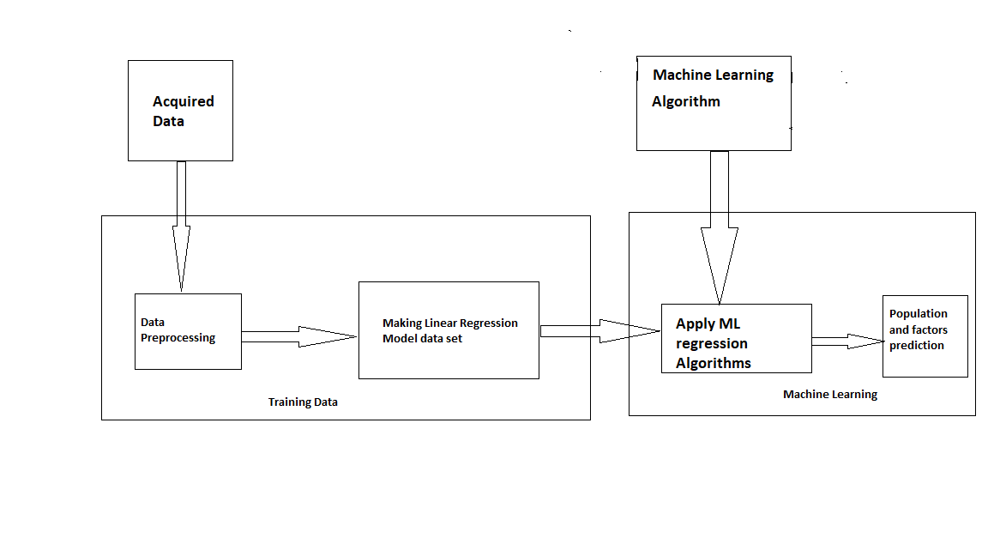
Workflow Diagram

Slide 6
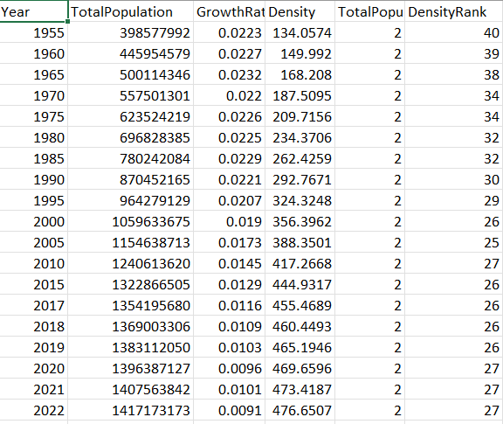
Dataset Used

Slide 7
Features Targetted in population dataset
Year
Growth Rate
Density
Density Rank
Total Population

Slide 8
Crucial Programming Libraries Used
NumPy
PANDAS
Matplotlib
Math
statsmodel.tsa
sklearn.neural-network
sklearn.metrics

Slide 9
Coding
General Algorithm used for the models for prediction –
Data acquisition
Splitting the data into training and test data
Defining the model
Fitting the model with the trained data
Making predictions on test data
RMSE and MAPE error calculation
Plot necessary plots
For ARIMA model data stationarity is tested using adfuller from statsmodel.tsa.stattools.

Slide 10
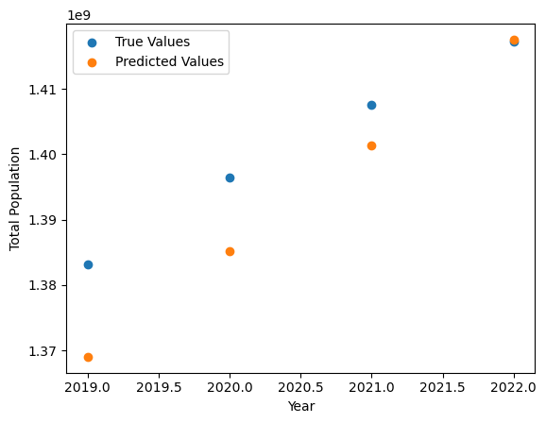
Results
Linear Regression Model:

Slide 11
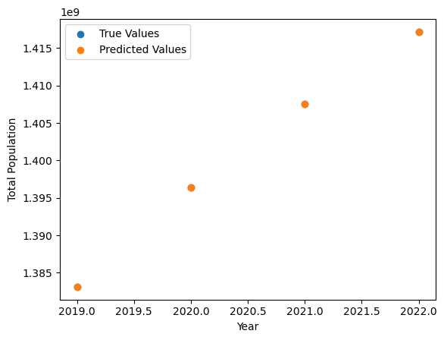
Multivariate Linear Regression Model:

Slide 12
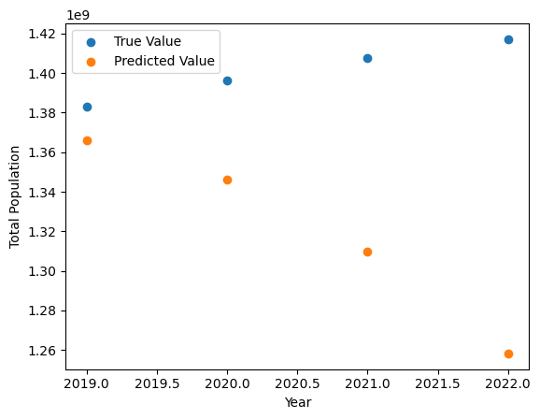
ARMA Model:

Slide 13
ANN Model:

Slide 14
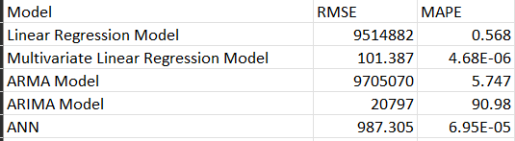
Comparison of Models

Slide 15
Model Performance
Multivariate Linear Regression(MLR) model and ANN model shows minimum error than other models and hence considered as best performing models.
Future population for the years 2025, 2030, 2035 have been calculated using MLR and ANN models.
As MLR model shows the best results, the density rank is also calculated using MLR model.

Slide 16

Population Forecast of Future

Slide 17
Visualisation and Comparison

Slide 18

Density Rank Prediction

Slide 19
Insights
As it can be seen that India’s population will be increasing in the upcoming years as well as density.
It can be a worrying sign as most of the developed countries with similar area size of India has lower density compared to India.
India can take development projects based on the developed countries which have lower density rank such as Macao, Singapore, etc.

Slide 20
Applications of Population Prediction Models
Health Planning and Resource Allocation
Demographic and Socio-Economic Planning
Environmental Planning and Management

Slide 21
Challenges
Data Quality and Availability
Unforeseen Changes in Population Characteristics
Model Complexity and Limitations

Slide 22
further development
It is important to be aware of the potential impact of unforeseen changes, and to continuously update and revise population prediction models in response to new information and changing circumstances.
The models can be developed and optimised with more available data. More correlations can be found, and more conclusions will result by doing so.

Slide 23
Conclusion
Machine learning algorithms can better estimate the country's future population by minimizing the factors that make it difficult to estimate the population of the country and by analyzing uncertainties on demographic data.
Therefore, the use of machine learning algorithms on population estimation will make an important contribution to the country.
Population prediction models can provide valuable information for planning and decision-making, but it is important to be aware of their limitations and to use them in conjunction with other sources of information and data.

Slide 24
Thank You

